Slide 1

Addressing Dataset Imbalance:
Upsampling and Downsampling Techniques
By: Wonjoon Hwang, Zhizheng Wang, Khoa Le, Chih-Yuan Tung, Brett Ruane

Slide 2
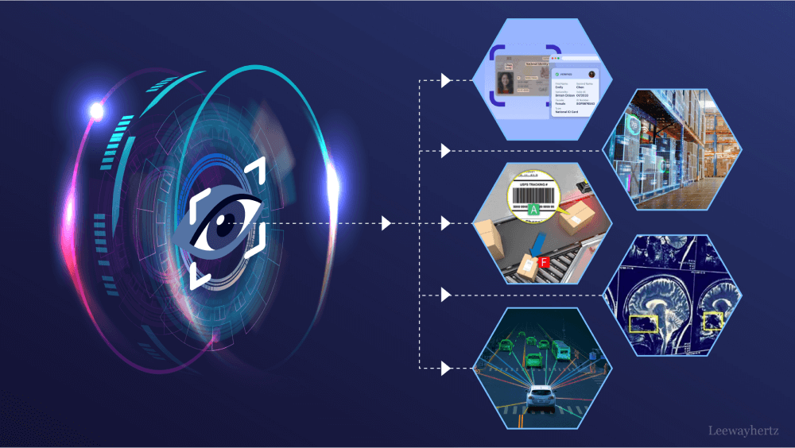
Table of Contents:
Introduction
Methods
Results
Conclusion

Slide 3
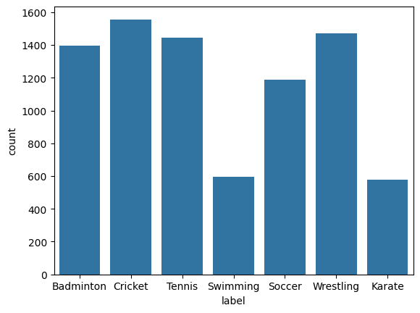
Introduction
Problem:
Classify Sport Images
Imbalance Dataset
Solution:
Resample Data (Upsampling and Downsampling)
Objective:
The find the best resampling techniques on various models
ResNet50, GoogLeNet, VGG16, AlexNet

Slide 4
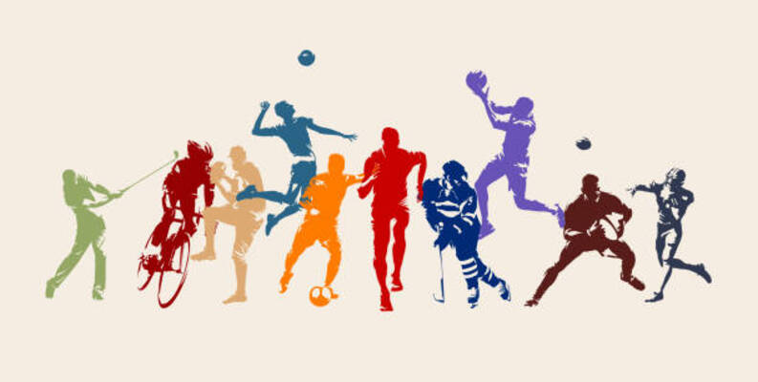
Data - Sport Images
Images:
Cricket : 1556
Wrestling : 1471
Tennis : 1445
Badminton : 1394
Soccer : 1188
Swimming : 595
Karate : 578
Source: https://www.kaggle.com/datasets/sidharkal/sports-image-classification/data

Slide 5
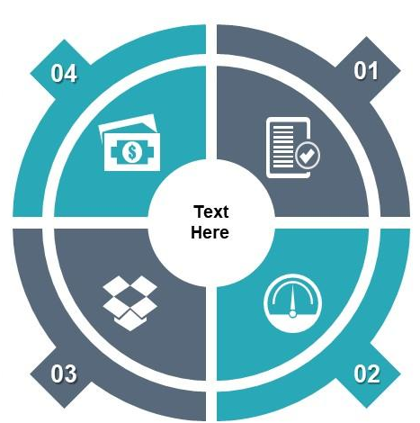
System Architecture
80% train, 20% validation
Already provided with a test set
Only 5 epochs
4 deep learning models
5 resampling techniques

Slide 6
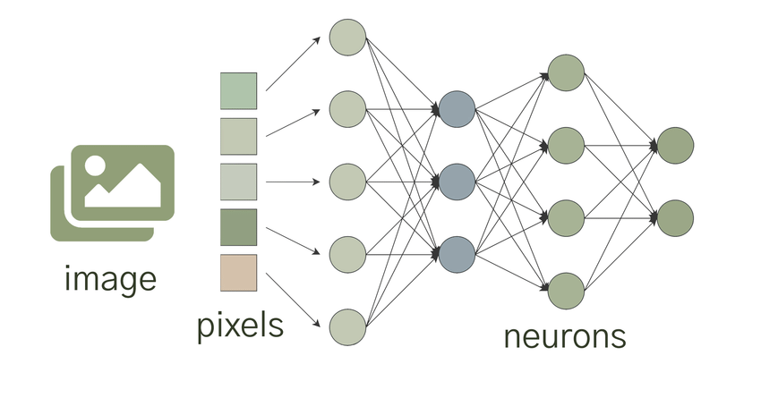
Deep Learning Models
ResNet50:
Residual connections for deeper networks
VGG16:
Sequential deep convolutional layers
GoogLeNet:
Inception modules with efficient computation
AlexNet:
Revolutionized CNNs with deeper architecture

Slide 7

Resampling Techniques
Nearest Neighbor Interpolation
Bilinear and Bicubic Interpolation
Gaussian Pyramid for Downsampling
Super-Resolution Using Deep Learning (SRCNN)
Wavelet Transform Resampling

Slide 8
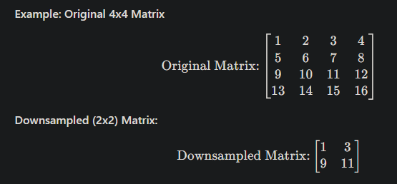
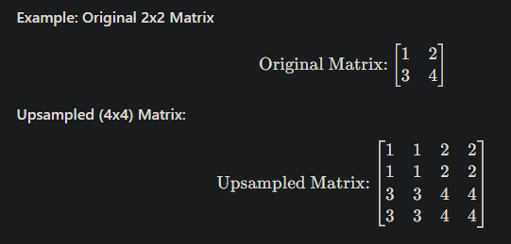
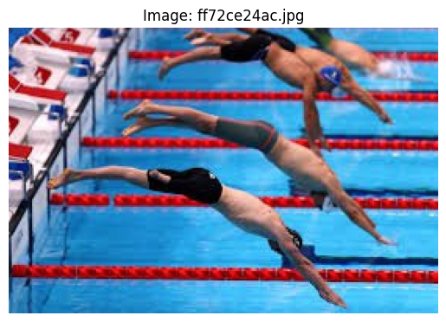
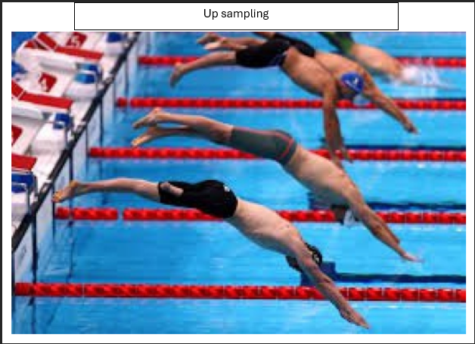
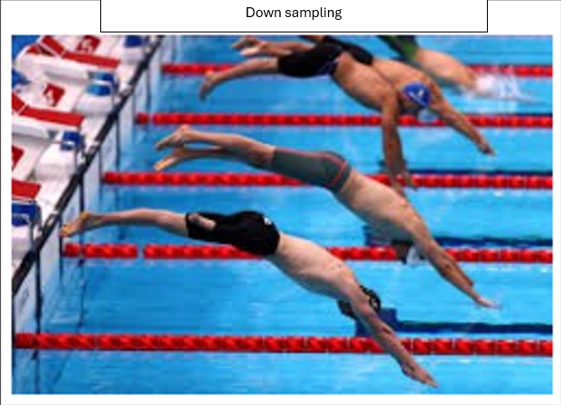
Part 1. Nearest Neighbor Interpolation
NNI: simple image resizing technique where the value of a pixel in the resized image is assigned to the value of the nearest pixel in the original image.
No averaging or blending
Fast and efficient

Slide 9
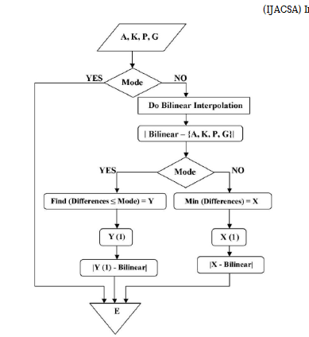
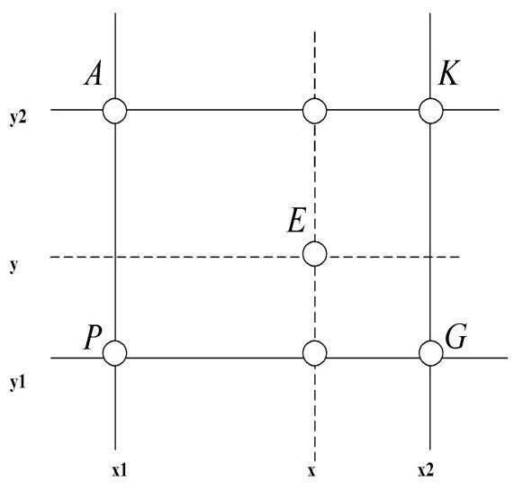
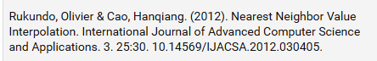
Part 1. NNI Process
Step 1: Set Target Dimensions
Define the new width and height for resizing.
Step 2: Apply Nearest Neighbor Resizing
Use the library’s resize function with NEAREST as the interpolation method: resized_image = cv2.resize(image, (width, height), interpolation=cv2.INTER_NEAREST)
Step 3: Integrate Into Pipeline
Pass the resized image to the deep learning model or further processing.

Slide 10
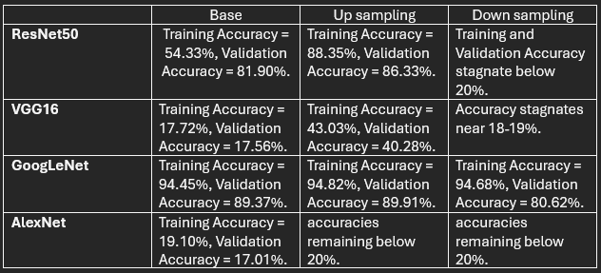
Part 1. NNI Results
Upsampling (NN interpolation):
Better performance of deeper models like ResNet50 and GoogLeNet.
Downsampling (NN interpolation):
Downsampling seems to hurt performance for most models. The accuracy remained very low

Slide 11
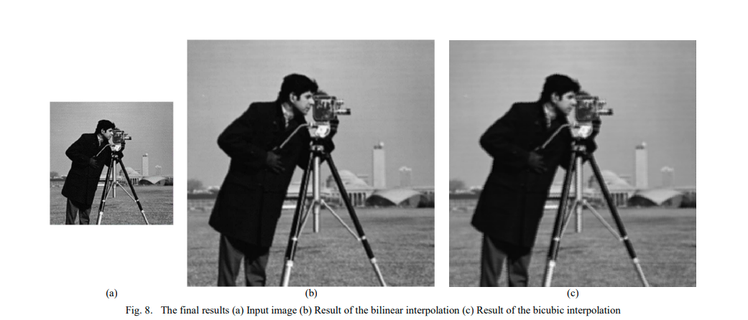
Part 2. Bilinear and Bicubic Interpolation
Purpose: To resample images by increasing or decreasing image resolution
Method:
Bilinear Interpolation: calculate distance weighted average of the 4 nearest pixel values
Bicubic Interpolation: calculate distance weighted average of the 16 nearest pixel values

Slide 12
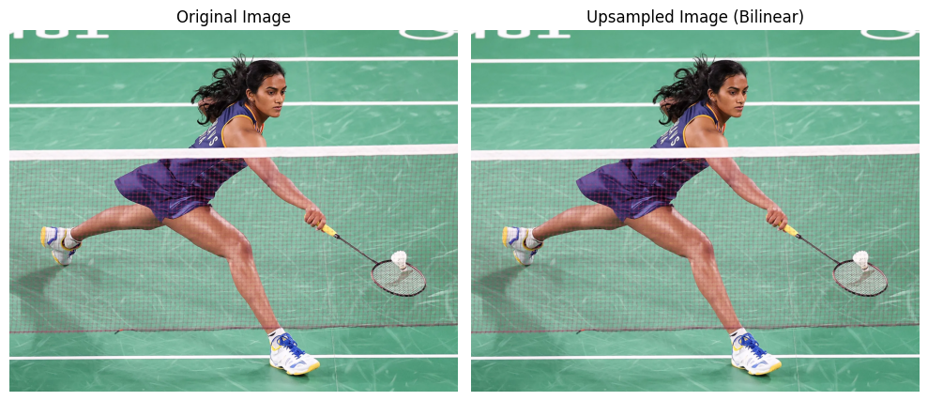
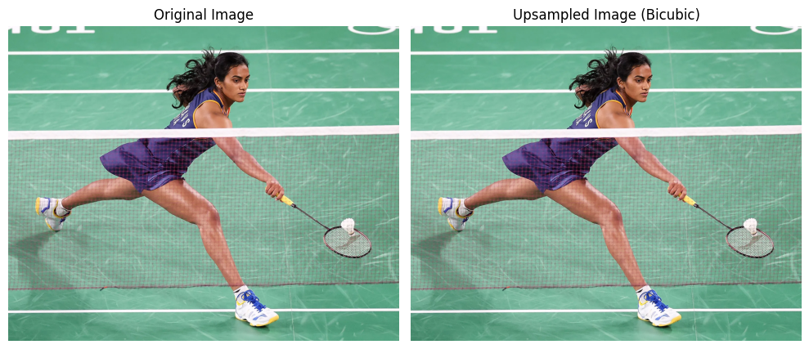
Example

Slide 13
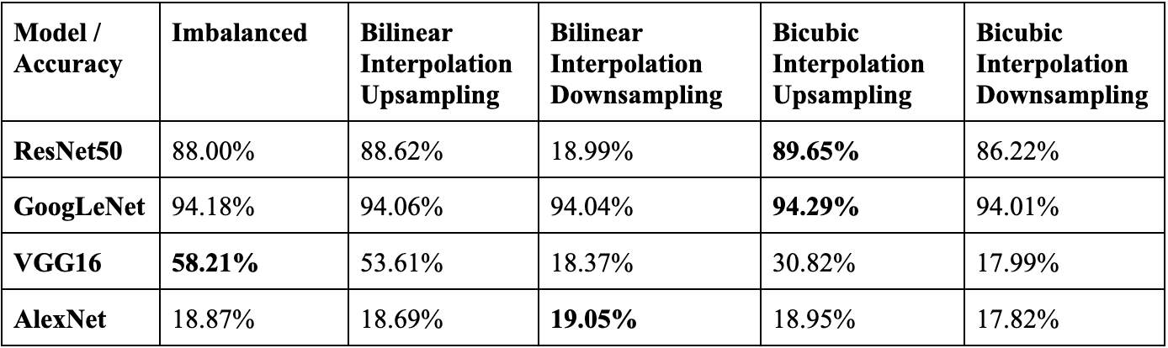
Part 2. Bilinear and Bicubic Interpolation Results
Characteristics:
Quality: Bicubic provides better quality and detail preservation than bilinear, especially for larger scaling factors.
Speed: Bilinear is faster and computationally cheaper than bicubic.

Slide 14
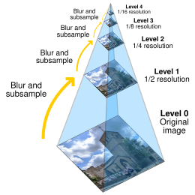
Part 3. Gaussian Pyramid for Downsampling
Definition: reduce the resolution of an image progressively by applying a Gaussian filter and resizing.
Key Concepts:
Gaussian Filter: Smooths the image to remove high-frequency noise.
Downsampling: Reduces the image size by keeping every second pixel.
Purpose:
Create multi-resolution representations.

Slide 15
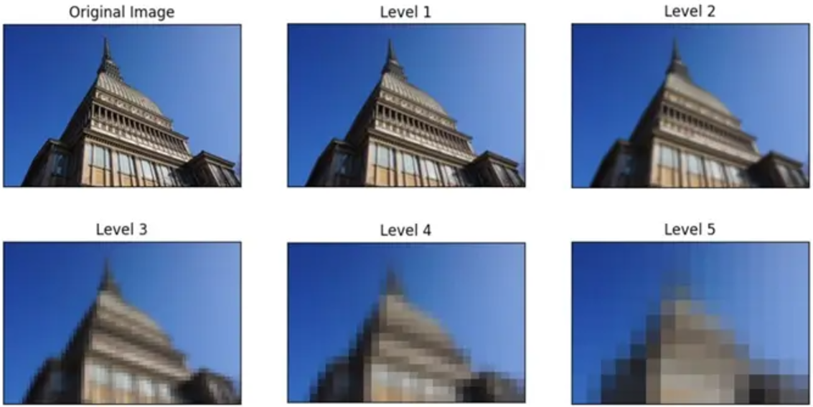
Part 3. Gaussian Pyramid Steps
Apply Gaussian Filter: Apply a Gaussian kernel to blur it slightly → Removes unnecessary fine details
Downsample: Reduce the size by taking alternate rows and columns
Repeat: Continue this process to create progressively smaller (lower-resolution) images.

Slide 16
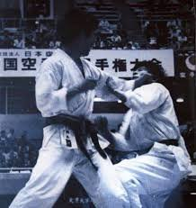
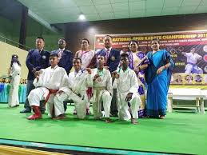
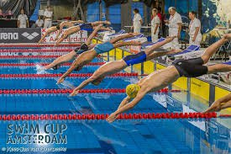
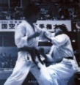

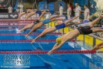
Examples

Slide 17
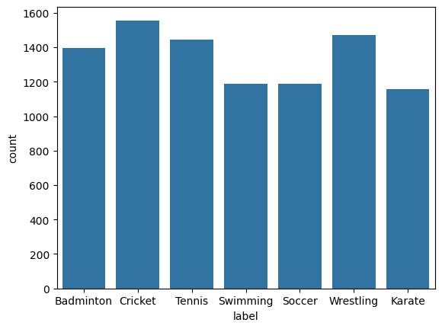
Part 3. Gaussian Pyramid Resampling
Images:
Cricket: 1556
Wrestling: 1471
Tennis: 1445
Badminton: 1394
Soccer: 1188
Swimming: 595 → 1190
Karate: 578 → 1156
Before
After

Slide 18
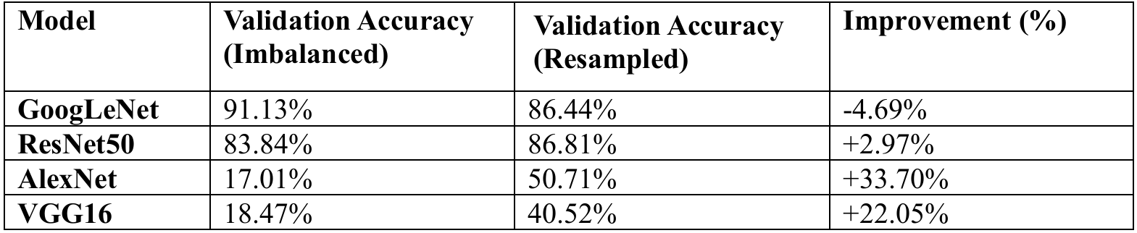
Part 3. Gaussian Pyramid Results
GoogLeNet and ResNet50 outperform AlexNet and VGG16.
Superior at capturing complex patterns.
Gaussian Pyramid resampling enhances the performance of simpler models.

Slide 19
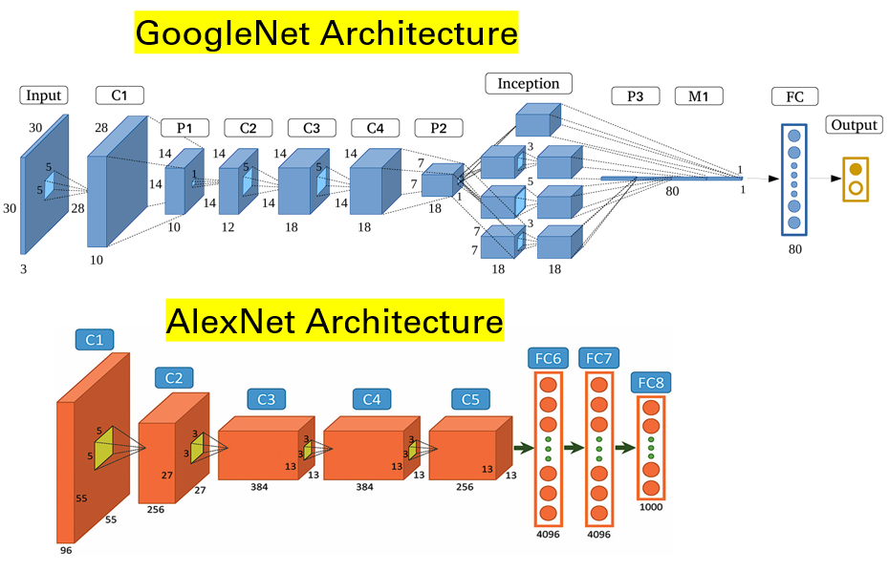
Part 3. Gaussian Pyramid Results

Slide 20
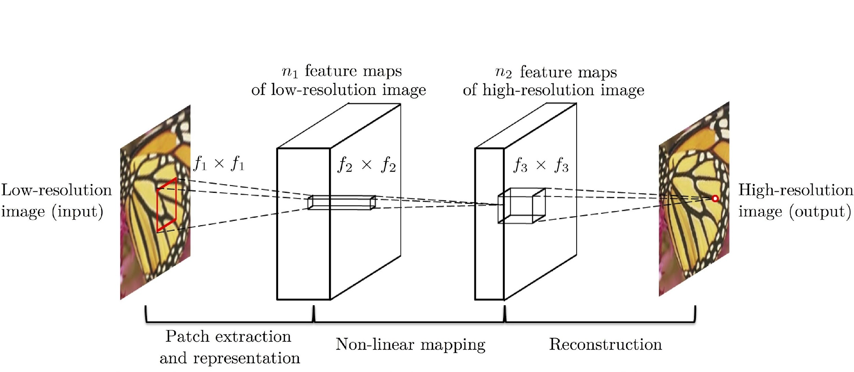
Part 4. Super-Resolution Using Deep Learning
Purpose: To improve the resolution of low-resolution images using a convolutional neural network (CNN).
Method: A three-layer CNN structure is used to perform image super-resolution.
Dong, Chao, et al. "Image super-resolution using deep convolutional networks." IEEE Transactions on Pattern Analysis and Machine Intelligence, vol. 38, no. 2, 2016, pp. 295–307, https://doi.org/10.1109/TPAMI.2015.2439281.

Slide 21
Part 4. Super-Resolution Using Deep Learning
Key Features:
Patch Extraction & Representation: Extracts overlapping patches from the low-resolution input to capture local features.
Non-linear Mapping: Maps the features to a high-dimensional space to learn complex mappings.
Reconstruction: Combines high-dimensional features to reconstruct a high-resolution image.
Dong, Chao, et al. "Image super-resolution using deep convolutional networks." IEEE Transactions on Pattern Analysis and Machine Intelligence, vol. 38, no. 2, 2016, pp. 295–307, https://doi.org/10.1109/TPAMI.2015.2439281.

Slide 22
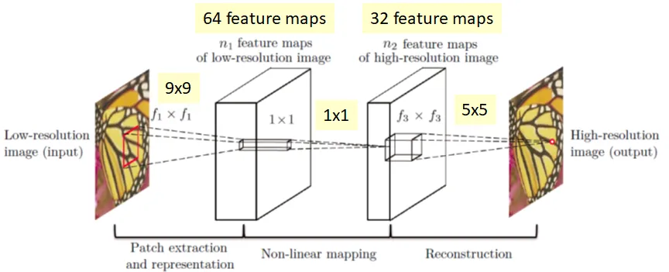
Part 4. SCRNN Pipeline
Load Model:
Load pre-trained SRCNN or initialize untrained model.
Image Augmentation:
Downscale and upscale images using SRCNN.
Class Balancing:
Identify underrepresented classes.
Augment until all classes reach target count.

Slide 23
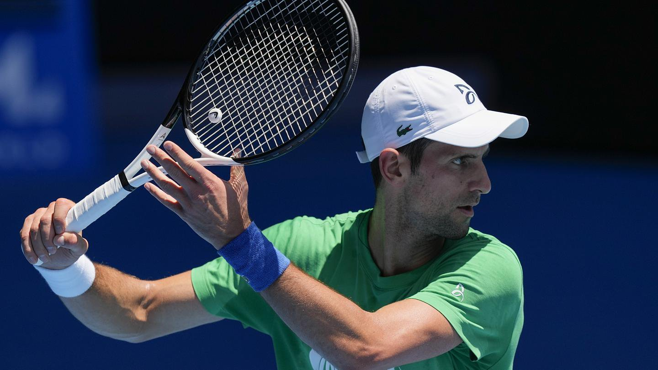
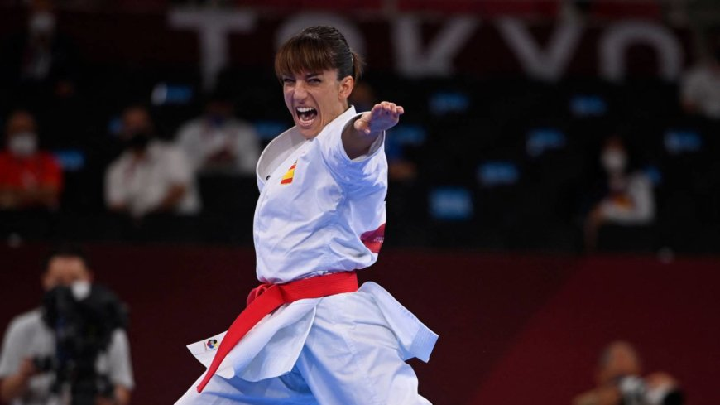
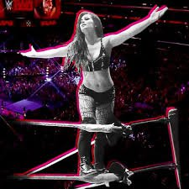
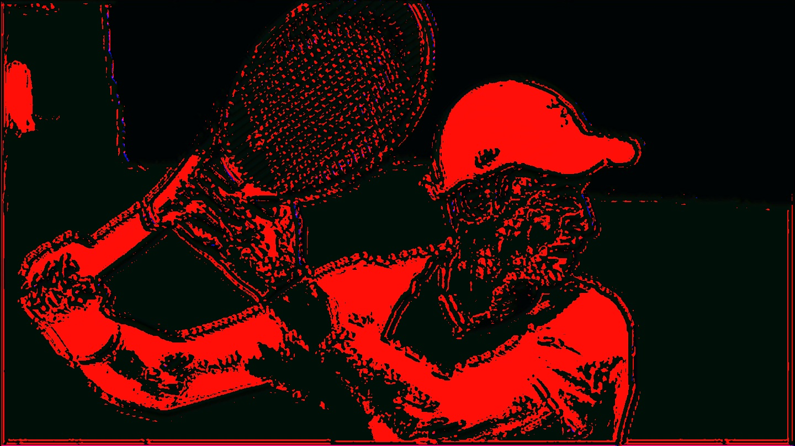
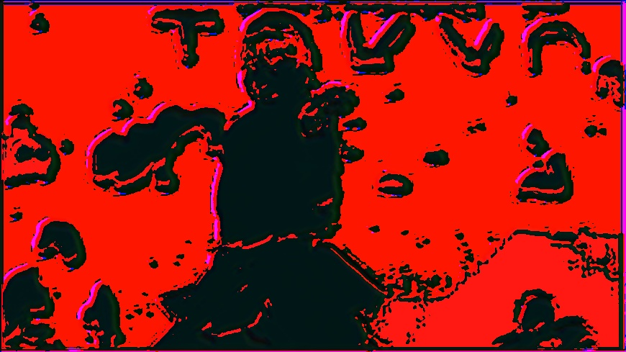
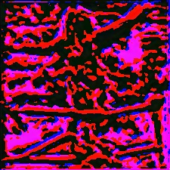
Example
Tennis
Karate
Wrestling
Original
After SRCNN

Slide 24
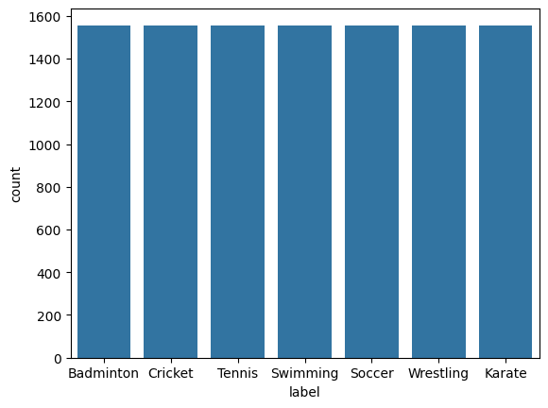
Part 4. SCRNN Results
Model | Initial Validation Accuracy | Post-Resampling Validation Accuracy
GoogleNet | 90.28% | 87.29%
ResNet50 | 81.35% | 80.77%
VGG16 | 17.44% | 40.52%
AlexNet | 18.47% | 50.71%
After SCRNN
Results

Slide 25
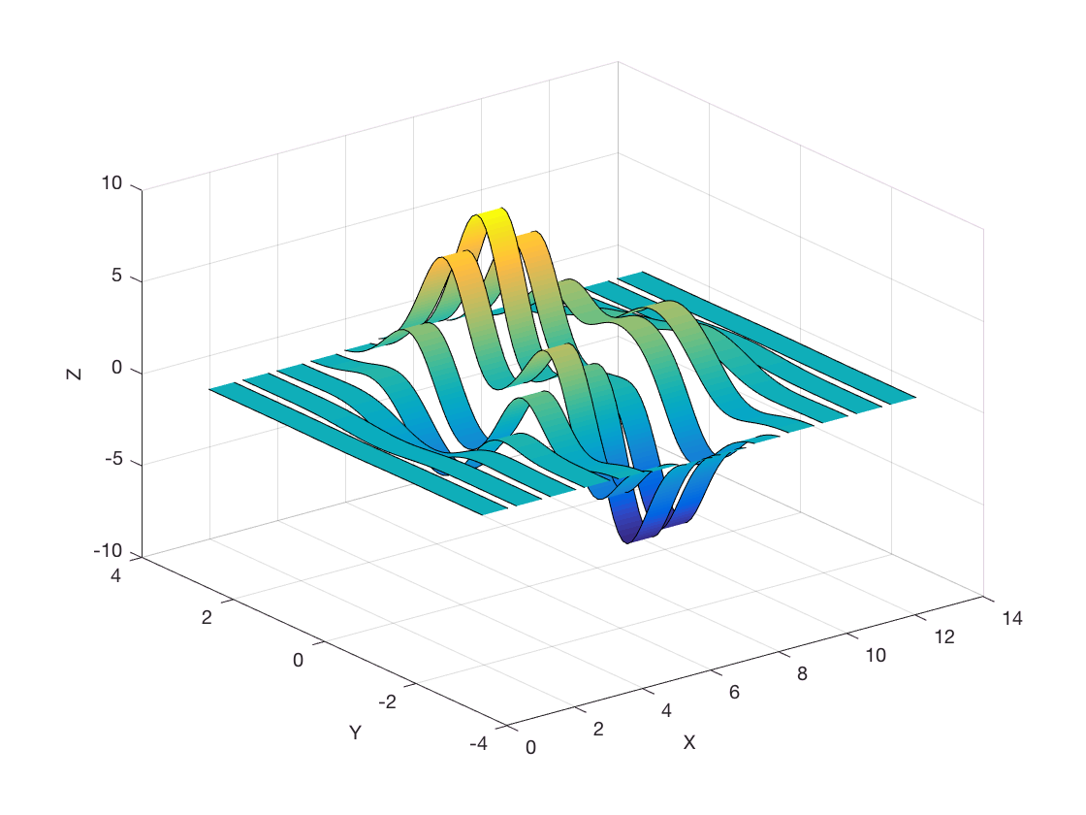
Part 5. Wavelet Transform Resampling
A signal processing technique to analyze data at multiple scales.
Feature Extraction: Identifies edges, textures, patterns.
Dimension Reduction: Compresses image retaining essential features
Low-frequency – approximation
High-frequency – detail

Slide 26
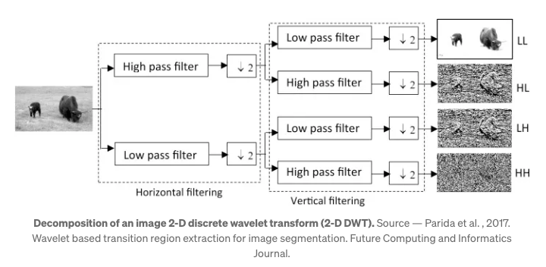
Part 5. Wavelet Transform Resampling
Low-Pass Filter (L):
Smooth variations in pixel intensity (low-frequency features).
Ex: Background, overall shapes
High-Pass Filter (H):
Sharp changes in pixel intensity (high-frequency features).
Ex: Edges, fine textures, object boundaries.
Horizontal - Vertical

Slide 27
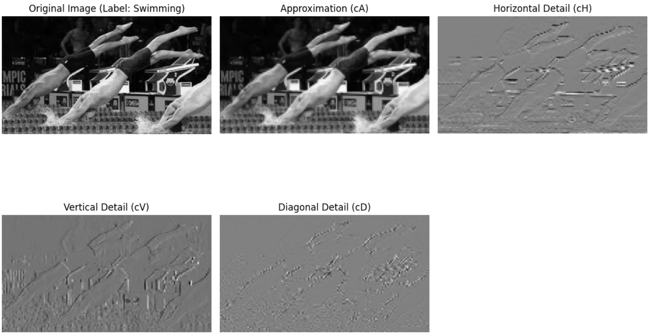
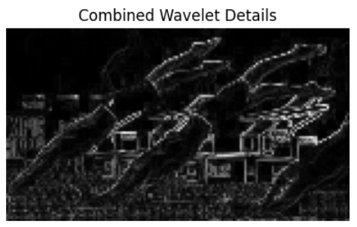
Part 5. Wavelet Transform Analysis
Approximation (cA):
Main structure
Horizontal Detail (cH): Horizontal variations
Vertical Detail (cV):
Vertical variations
Diagonal Detail (cD):
Diagonal variations

Slide 28
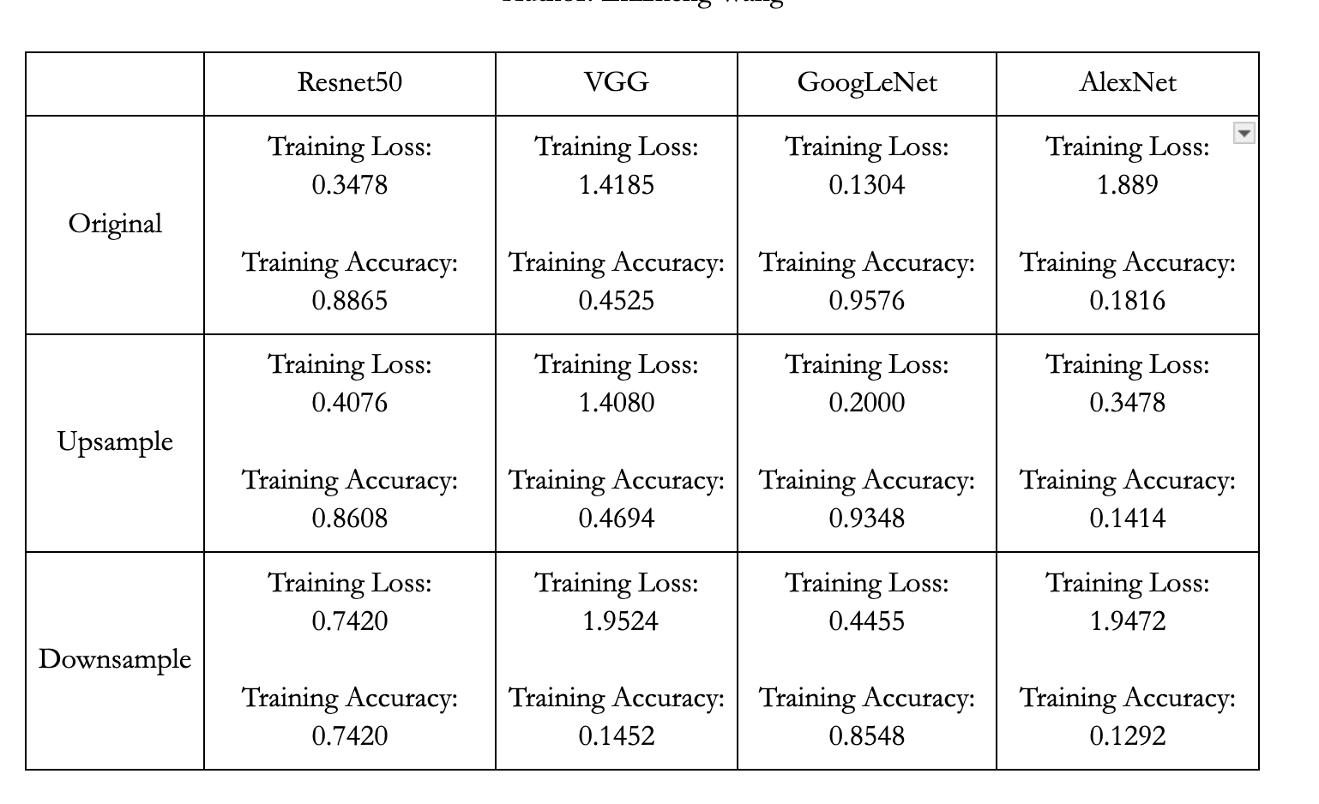
Part 5. Wavelet Transform Evaluation
Upsampling:
Synthetic images lacked diversity and realism.
Impact: Overfitting
Downsampling:
Lowered Resolution(128 × 128)
Removed excess images.
Lost important features
Impact: Reduced performance across all models.

Slide 29
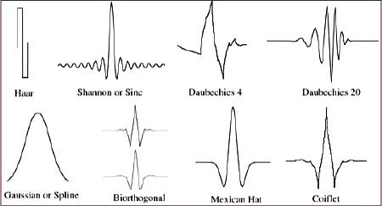
Part 5. Wavelet Transform Conclusion
Best Model: GoogLeNet
Future Work:
Wavelet Coefficient Optimization
Adaptive Wavelet Filtering
Image Resolution

Slide 30
Conclusion
Bicubic Interpolation Upsampling improves ResNet50
Wavelet Transformation Upsampling improves VGG16
Nearest Neighbors Interpolation improves GoogLeNet
SCRNN Upsampling improves AlexNet
However, it is still bad so nothing can save AlexNet ☹️

Slide 31
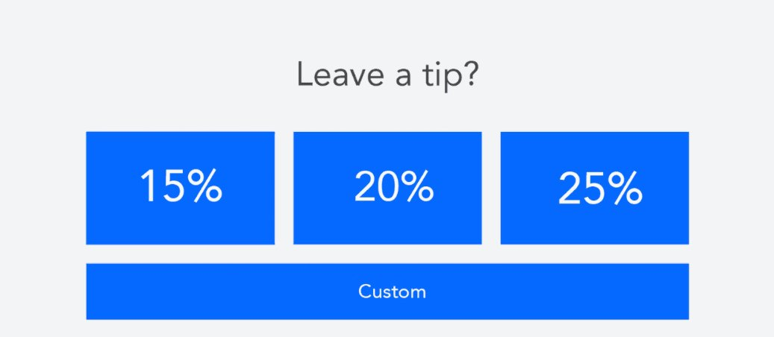
Thank you!

Slide 32
Reference
Bashir, Syed Muhammad Arsalan, et al. "A comprehensive review of deep learning-based single image super-resolution." PeerJ Computer Science 7 (2021): e621.
Dong, Chao, et al. "Image super-resolution using deep convolutional networks." IEEE Transactions on Pattern Analysis and Machine Intelligence, vol. 38, no. 2, 2016, pp. 295–307, https://doi.org/10.1109/TPAMI.2015.2439281.
Mallat, S., & Hwang, W. L. (1992). Singularity detection and processing with wavelets. IEEE Transactions on Information Theory, 38(2), 617–643. https://doi.org/10.1109/18.119727
Rukundo, Olivier, and Hanqiang Cao. "Nearest neighbor value interpolation." arXiv preprint arXiv:1211.1768 (2012).
Verma, Atul & Saini, Barjinder. (2017). Forward-backward processing technique for image denoising using FDZP 2D filter. Journal of Applied Research and Technology. 15. 10.1016/j.jart.2017.07.001.

